Slide 1
Palliative Care
Building Bridges

Slide 2
“You matter because you are you. You matter to the last moment of your life, and we will do all we can, not only to help you die peacefully, but to live until you die”.
Dame Cicely Saunders
Notes:
Founder of St. Christopher’s Hospice
London, England

Slide 3
“I would like to die in my sleep”, “I just want to go to sleep and not wake up”, “I am not afraid of death as I am of the process of dying.”
These are common statements that we hear all the time, the vast majority of whom will not die suddenly; the majority of us will die as a result of a long-term, chronic illness.
In the progression of chronic illness, we will most likely experience distress due to symptoms like pain, dyspnea, or fatigue. We will also suffer from loss of ability, decreased independence, cognitive changes and emotional or spiritual distress.
Palliative interventions can be initiated earlier in the course of disease. Whereas end-of-life care, focuses on the last months of a patient’s life.
Notes:
Last months or even weeks of a patient’s life
As a nurse, Nurses are in a unique position to address these complex symptoms with palliative care. Be the patient’s advocate

Slide 4
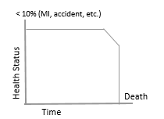
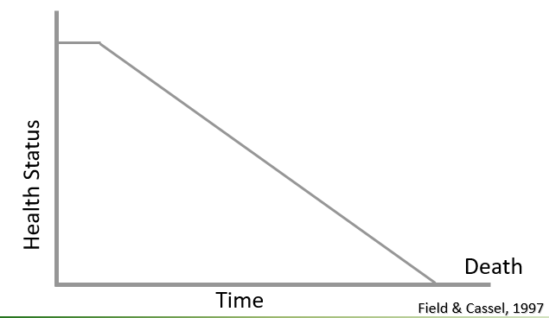
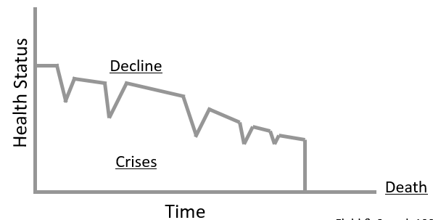
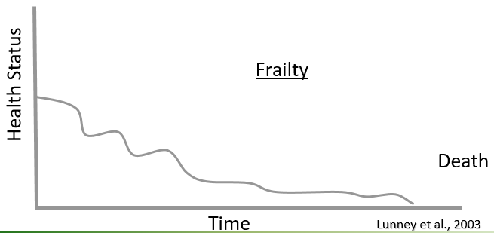
Trajectories for Illness and Disease
Notes:
Disease and dying trajectories illustrate differences in the dying experience by examining the duration of the dying process and the course of the disease or injury.
First box :A sudden death, unexpected cause (e.g., MI, car accident, act of hate/terrorism, etc.) (Field & Cassel, 1997).
Second box: Steady decline, short terminal phase (e.g., pancreatic cancer) (Field & Cassel, 1997).
Third box: Chronic illness with periodic crises, and death (e.g., congestive heart failure, COPD, end-stage liver disease, AIDS, etc) (Field & Cassel, 1997).
Periodic acute exacerbation
High symptom burden
Prognostication is challenging (Quill et al., 2014, p.4)
Fourth box: Lingering expected death (e.g., frailty, such as an older adult who is declining but no specific acute cause of death) (Lunney et al., 2003).
Prolonged and gradual physical and cognitive decline with increased fatigue, weight loss, food/fluid intake.
Multiple co-morbidities, Caregiver support is critical.
Prognostication is difficult (Quill et al., 2014).

Slide 5
What is Palliative Care?
Palliative care, and the medical sub-specialty of palliative medicine, is specialized medical care for people living with serious illness.
It focuses on providing relief from the symptoms and stress of a serious illness.
The goal is to improve quality of life for both the patient and the family.
Palliative care is provided by a team of palliative care doctors, nurses, social workers and others who work together with a patient’s other doctors to provide an extra layer of support.
It is appropriate ay any age and at any stage in an illness and can be provided along with curative treatment
Notes:
CAPC Definition – center to advance palliative care www.capc.org

Slide 6
Characteristics of Palliative Care Philosophy and Delivery
Interdisciplinary care
Excellent communication between patients, families, health care providers
Services provided concurrently with or independent of curative/life‐prolonging care
Hopes for peace and dignity are supported throughout the course of illness and pre-post dying process
NCP, 2013
Notes:
The palliative care philosophy and delivery can be characterized as (National Consensus Project (NCP), 2013):
Care is provided and services are coordinated by an interdisciplinary team.
Patients, families, palliative and non-palliative health care providers collaborate and communicate about care needs.
Services are available concurrently with or independent of curative or life‐prolonging care.
Patient and family hopes for peace and dignity are supported throughout the course of illness, during the dying process, and after death.

Slide 7
Notes:
Palliative care throughout the continuum of illness involves addressing physical, intellectual, emotional, social, and spiritual needs and to facilitate patient autonomy, access to information, and choice.
It emphasizes use of an interdisciplinary team approach throughout the continuum of illness, placing critical importance on the building of respectful and trusting relationships

Slide 8
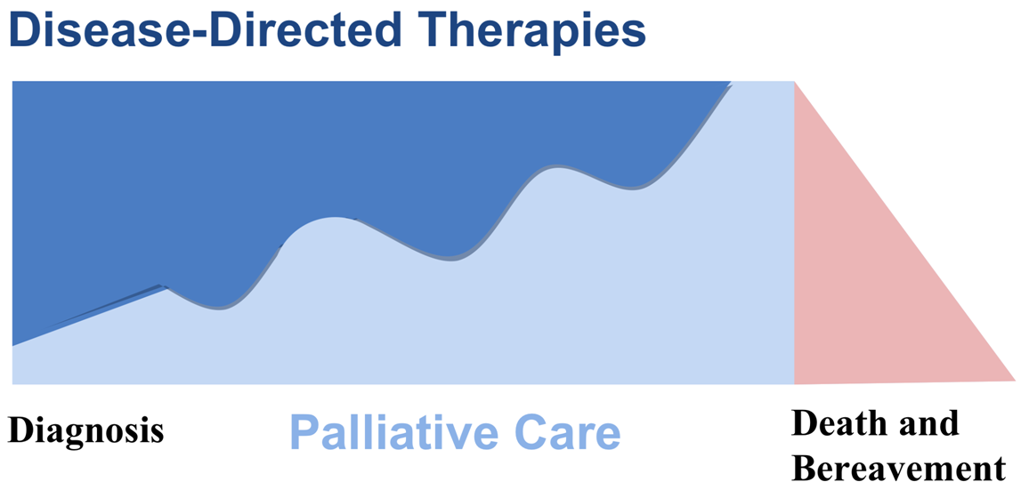
Palliative Care is Provided Parallel with Curative Treatment
Diagnosis
Hospice or
Survivorship
Core competencies in palliative care
Specialty palliative care
8
Notes:
Not all palliative pts will go on hospice some are supported through tx & cured ex head & neck
This diagram delineates the continuum for palliative and hospice care as the disease progresses and the patient enters into the terminal phase of illness (NQF, 2006).

Slide 9
8 Domains of Palliative Care
Domain 1: Structure and Processes of Care
Reflect the interdisciplinary mode of care designed to enhance patient and family inclusion in the decision-making process related to palliative care services and encompasses physical, psychosocial, emotional and spiritual care and processes.
Domain 2: Physical Aspects of Care
Focus on assessment and treatment of pain and symptoms using standardized assessment tools and treatment protocols that are safe and effective, emphasizing patient and family directed holistic care

Slide 10
8 Domains of Palliative Care
Domain 3: Psychological and Psychiatric Aspects
Reflect the collaborative nature of holistic care with a focus on assessment and management of psychological and psychiatric care needs in the context of serious illness.
Domain 4: Social Aspects of Care
Emphasizes the interdisciplinary care and collaboration with patients, families and caregivers with the goal of supporting the patient and family and identifying strengths and areas of need.

Slide 11
8 Domains of Palliative Care
Domain 5: Spiritual, Religious, and Existential Aspects of Care
Addresses assessment including the importance of screening for unmet needs and management of spiritual care needs with the goal of providing spiritual comfort and religious services to the patient and family/caregivers.
Domain 6: Cultural Aspects of Care
Focus on cultural strengths and the ways in which culture influences both palliative care delivery and the experience of that care by the patient and family, from the time of diagnosis through death and bereavement and may include support for the patient and family and in practices and rituals that reflect cultural influences important to them

Slide 12
8 Domains of Palliative Care
Domain 7: Care of the Patient Nearing the End of Life
Focus on the symptoms and situations that are common in the final days and weeks of life.
Domain 8: Ethical and Legal Aspects of Care
Ensure the patient and family are knowledgeable in advance care planning, surrogate decision-making, regulatory and legal considerations, and related palliative care issues, focusing on ethical aspects of care and processes to support patient autonomy .

Slide 13
THE VALUE OF PALLIATIVE CARE FOR THE PATIENT
Reframing hope
What are their goals
What do they want to accomplish
Reach what is possible
Having the difficult conversation
Telling the patient/caregivers what their options are
Having them make the decision
Ongoing conversations – don’t shut the door
Be open about treatment
Curative vs treating symptoms
Quality of life vs disease
Strong evidence that palliative care improves quality, satisfaction, and cost appropriateness
Notes:
What is their goal – what do they want to do, - wedding, event, trip, “ bucket list”
Conversation – where were they last year, a holiday, where do they want to see themselves in 3, 6 , 9 months. Treat them as a person .
Palliative care focuses on different lens
Underlying all of this is caring . Caring is so important, how do we answer their questions, are we listening, are we present? When we cross the threshold, sit with a patient- leave everything at door…

Slide 14
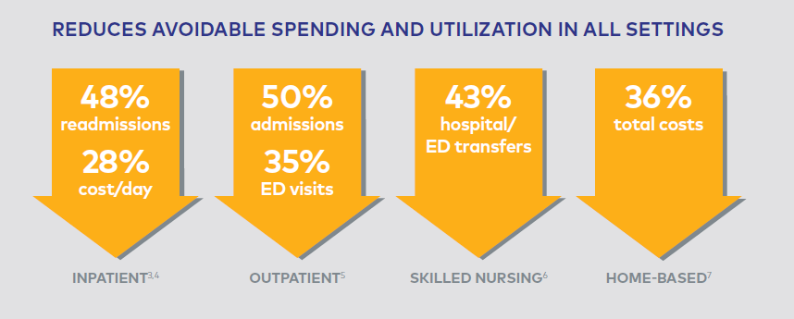
Palliative Care Improves Cost Effectiveness
Notes:
It is always important to show the data

Slide 15
Palliative Care Improves Quality Scores
 | Medicare ACOs | Health Plans/MA Plans | Medicaid Plans
All-Cause Readmissions | ✓ | ✓ | ✓
SNF All-Cause Readmissions | ✓
ED Utilization |  | ✓
All-Cause Unplanned Admissions | ✓
Ambulatory Sensitive Admissions | ✓ |  | ✓
Depression Screen/Follow | ✓ | ✓
Relative Resource Use (Total Cost) | ✓ | ✓ | ✓
Experience of Care (CAHPS) | ✓ | ✓ | ✓

Slide 16
Palliative Care Programs
Different Models
Support for the patient and family in managing serious and life-limiting illness.
An interdisciplinary team approach to care
Ongoing communication among patients, families and providers
Advance care planning and patient centered decision-making
Care coordination/case management to simplify access to services and monitor quality of care
Anticipatory guidance in coping with illness, grief and issues of life review and closure
Bereavement support
Notes:
Different models: home based under Home Health benefit if meet criteria; palliative NPs & Docs under Part B; Advanced illness programs

Slide 17
Barriers to Palliative Care
Palliative care and hospice services are poorly understood and confused
Lack of education/training for healthcare providers
Workforce that is too small to meet demands
Failure to acknowledge the limits of medicine
Lack of payment models
Rules and regulations
Denial of death
Advance Directives lacking
Notes:
There are many barriers. Some of the most common barriers include:
Failure to acknowledge the limits of medicine may lead to futile care and the use of inappropriate and aggressive curative treatments that can prolong the dying process and contribute to physical and emotional suffering (CAPC, 2015).
Lack of adequate training of professionals especially in controlling pain and other symptoms:
Addressing only the physical aspects of care, and not assessing the psychological, social, and spiritual needs.
Many healthcare professionals are uncomfortable communicating bad news and prognosis.
Lack of role models in end of life care for not only current staff, but for students who are preparing for various roles in healthcare.
Delayed access to hospice and palliative care services occurs because those services are not well understood, and there remains confusion over when it is appropriate to consult or transfer care to palliative care.
Because of this delay, patients and families do not reap the full benefits of hospice and palliative care services.
Rules and regulations often impede good end-of-life care (\
Regulation of controlled substances has led to fear of prosecution for prescribing and administering medications to relieve pain and other symptoms.
Issues regarding access to care, insurance coverage.
Denial of death prevents many from accessing palliative care.
A lack of payment models that link to quality measures are few. Congressional legislation is pending that would facilitate research, professional development and public education in palliative care.

Slide 18
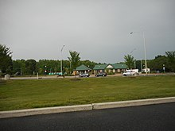
Notes:
The New Jersey Turnpike, like so many things in New Jersey, is horrible, which is also why it’s magnificent. It’s 122 miles long, bisecting the state on the diagonal — the southwest terminus is just short of the Delaware Memorial Bridge, where the turnpike is a blandly rural four-lane highway edged with dense wall of trees, farms, clear…

Slide 19
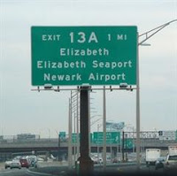
Notes:
by the time you reach the northeast terminal, at the George Washington Bridge, it’s morphed into an asphalt-tentacle beast, confusing, engorged, at its widest, to 12 lanes on four distinct roads, surrounded by oil refineries and other forms of outer-city industrial sprawl, all of them plaited with exits and sub-exits and interchanges. The signage is atrocious and the urban planning is deranged; you are never going to take the right exit for Newark Airport, but that’s okay, because there are three other rapid-fire exits that will get you there.
That’s the vision of living with a serious life limiting illness without palliative interventions - It is up to us to improve the landscape

Slide 20
“… touching the dying, the poor, the lonely, and the unwanted according to the grace we have received and let us not be ashamed or slow to do the humble work.”
-Mother Teresa

Slide 21
Questions/ Comments
Loretta Winde BSN, RN, COS-C, ACRN, HHCCM
LD131@aol.com
Lwinde@hopehealthco.org

